Slide 1
Shifts in Belgian spatial inequality between 1896 and 2010
Erik Buyst
Department of Economics
KU Leuven

Slide 2
Structure
Introduction
Unreliable official provincial GDP data before 1995 ESA?
The Geary and Stark method
Long term patterns of spatial inequality
The resource-based economy of the late 19th and early 20th centuries
The interwar period and the 1950s
The emergence of regional policies: solution of failure?
Speculations about future developments
Conclusion

Slide 3
Introduction
International effort to reconstruct historical regional accounts that cover the whole 20th century (Combes et al., 2011; Enflo and Rosés, 2015; Felice, 2011, etc.).
How did Belgian spatial inequality change from a long term perspective?
Official provincial GDP figures are available from 1955 onwards: are they reliable and what happened before?

Slide 4
Unreliable official provincial GDP data?
In the year 2000 the introduction of 1995 ESA gave rise to a major revision of sources and estimation procedures.
The old top-down approach used by ESA 1979 and before was replaced by a bottom-up method.
For the overlapping year of 1995 we observe major revisions of the provincial GDP figures (ICN, 2000, 2001).

Slide 5
Table 1: Relative provincial GDP per head in 1995 (current prices, Belgium = 1)
 | 1979 ESA | 1995 ESA | Difference (in %)
Antwerp | 1,22 | 1,17 | -4,1
Brabant | 1,12 | 1,40 | 24,5
West Flanders | 1,04 | 0,91 | -12,8
East Flanders | 0,94 | 0,87 | -6,9
Hainaut | 0,72 | 0,67 | -7,1
Liège | 0,88 | 0,78 | -11,1
Limburg | 0,99 | 0,85 | -14,0
Luxembourg | 0,86 | 0,81 | -6,7
Namur | 0,76 | 0,71 | -7,6

Slide 6
The Geary and Stark method
GS method (Geary & Stark, 2002) has become the international standard to reconstruct historical regional GDP figures (e.g. Enflo and Rosés, 2015; Felice, 2011).
Method divides economy in three sectors: agriculture, industry, and services.
Employment figures for each sector per sector are taken from census data.
National output of each sector is allocated to each province according to sector employment per province multiplied by sector labour productivity in each province.

Slide 7
The Geary and Stark method
Problem: no historical data on sector labour productivity per province.
GS method assumes that variations in provincial wage rates in each sector provide a reliable proxy.
Does the GS method work for Belgium?

Slide 8
Table 2: Relative provincial GDP per head in 2001 (current prices, Belgium = 1)
 | Official 1995 ESA | GS | Difference (in %)
Antwerp | 1,15 | 1,11 | -3,4
Brabant | 1,44 | 1,44 | 0,3
West Flanders | 0,94 | 0,91 | -2,4
East Flanders | 0,87 | 0,88 | 1,7
Hainaut | 0,66 | 0,67 | 1,4
Liège | 0,75 | 0,78 | 4,8
Limburg | 0,84 | 0,85 | 1,0
Luxembourg | 0,68 | 0,70 | 2,5
Namur | 0,69 | 0,72 | 5,4

Slide 9
Long term patterns of spatial inequality
What picture emerges from the GS-exercise?
Evolution of the population-weighted coefficient of variation of provincial GDP per capita
= proxy of σ-convergence
Proxy of β-convergence

Slide 10
Figure 1: σ-Convergence among Belgian provinces, 1896-2010

Slide 11
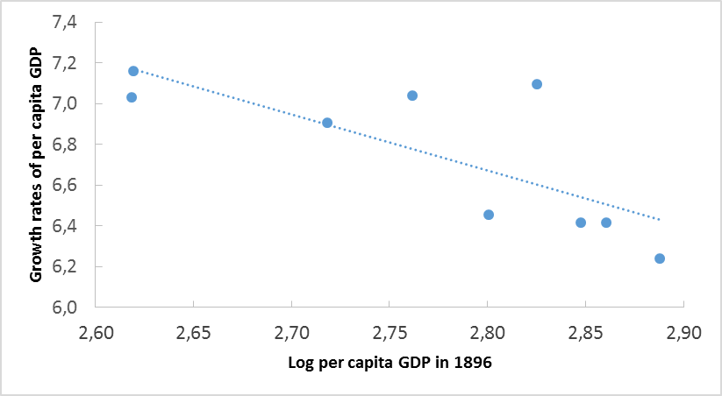
Figure 2: β-Convergence among Belgian provinces, 1896-2010

Slide 12
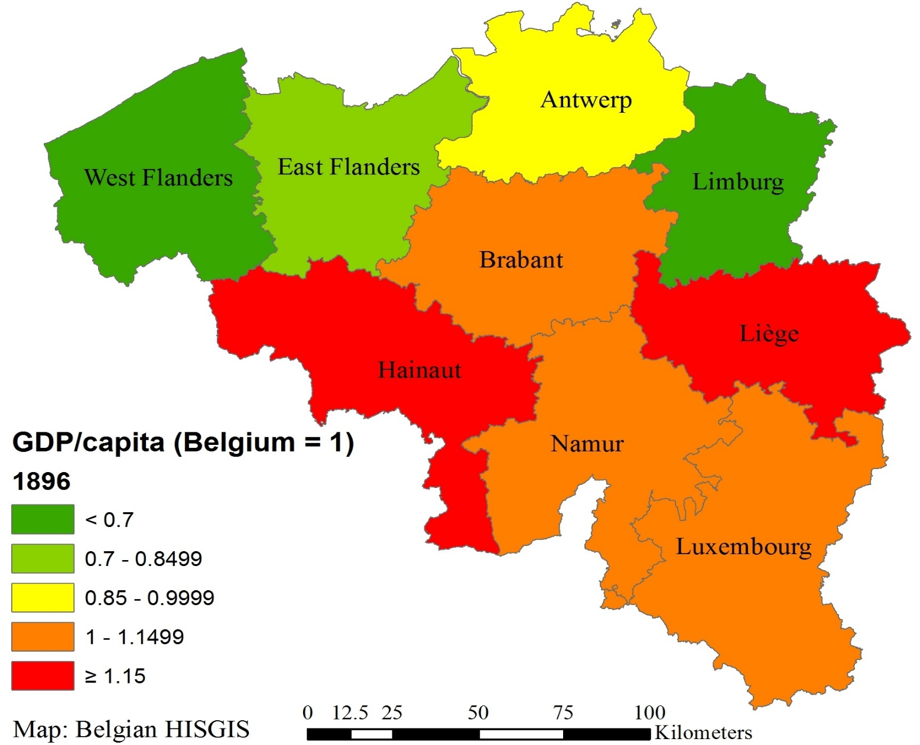
Map 1: Relative regional GDP per capita in 1896 (current prices, Belgium = 1)

Slide 13
The resource-based economy of the late 19th and early 20th centuries
Coal mines dictate where modern industries can flourish (Pollard, 1982)
Hainaut and Liège: iron & steel, machine building, glass, etc.
Business people participate vigourously in the ‘first global economy’.
North-west Belgium = example of failed industrialization
Flemish rural linen industry collapses.
Sweat shops: lace, shoemaking, artisanal sectors.
Brabant = intermediary position: luxury industries and tertiary activities in Brussels.

Slide 14
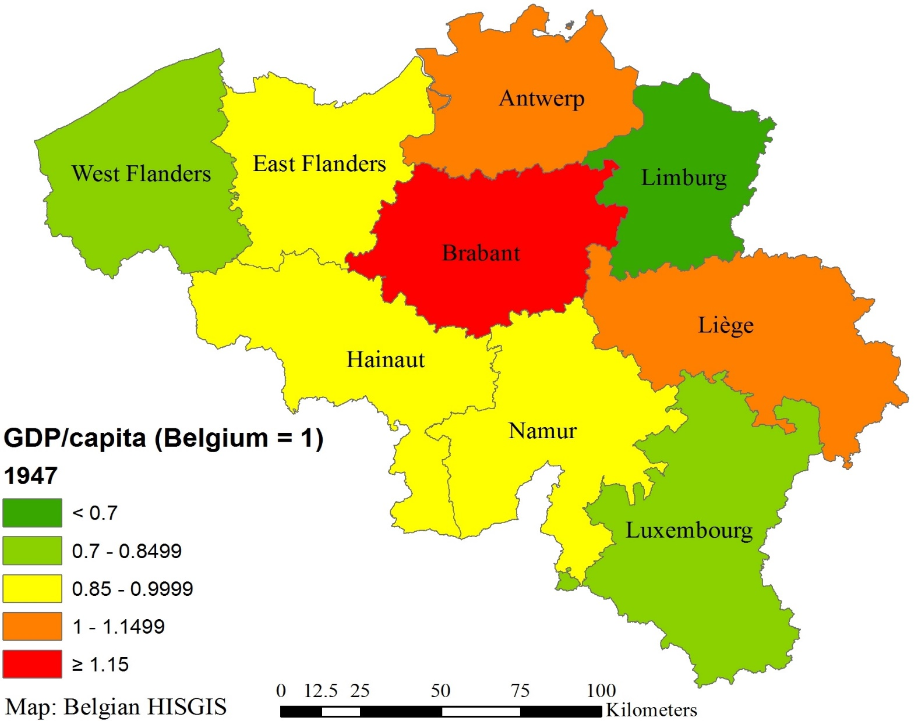
Map 2: Relative regional GDP per capita in 1947 (current prices, Belgium = 1)

Slide 15
Interwar period and the 1950s
Interwar period: relative weakening of coal mining axis
Exhaustion.
Exports of locomotives and rolling stock are hit by import substitution policies.
Strong performance of the port of Antwerp.
New industrial sectors: car assembly, photographic paper, telephone.
Logistics, finance & insurance.
Brabant: metal processing, fashion, tertiary sector.

Slide 16
Interwar period and the 1950s
1950s:
Breakthrough of oil: dozens of coal mines in Wallonia have to be closed.
East and West Flanders: relatively high unemployment rates because of decline of labour intensive industries, such as textiles, clothing and shoe-making.
Big winner = Brabant.
Strong expansion of welfare state.
Trade, finance.

Slide 17
Emergence of regional policies: solution or failure?
In 1959 government responds to spatial inequality problems by launching the ‘expansion laws’.
Various forms of tax incentives and the development of industrial zones should lure (foreign) investments to areas in difficulties.
Does not help Hainaut and Liège.
High wages in mining have pushed up salaries.
Downward rigidity of wages when mines disappear.
Competitiveness problem: little reconversion of activities.

Slide 18
Emergence of regional policies: solution or failure?
Northern provinces benefit from breakthrough of oil.
Refineries, petrochemicals in Flemish ports.
Relatively low wages in northern provinces, easy access to the sea.
Massive inflow of FDI (treaty of Rome, 1957): car assembly, consumer durables,…
More than compensates decline of textiles.

Slide 19
Emergence of regional policies: solution or failure?
In late 1970s and early 1980s Hainaut and Liège are badly hit by steel crisis.
Northern provinces suffer as well: textiles, clothing, shipbuilding, but recover more quickly in late 1980s.
Chemicals, new niche markets for textiles, copper refining.
Brussels: ‘capital of Europe’
Continuous extension of EU.
Law firms, lobby firms, etc.

Slide 20
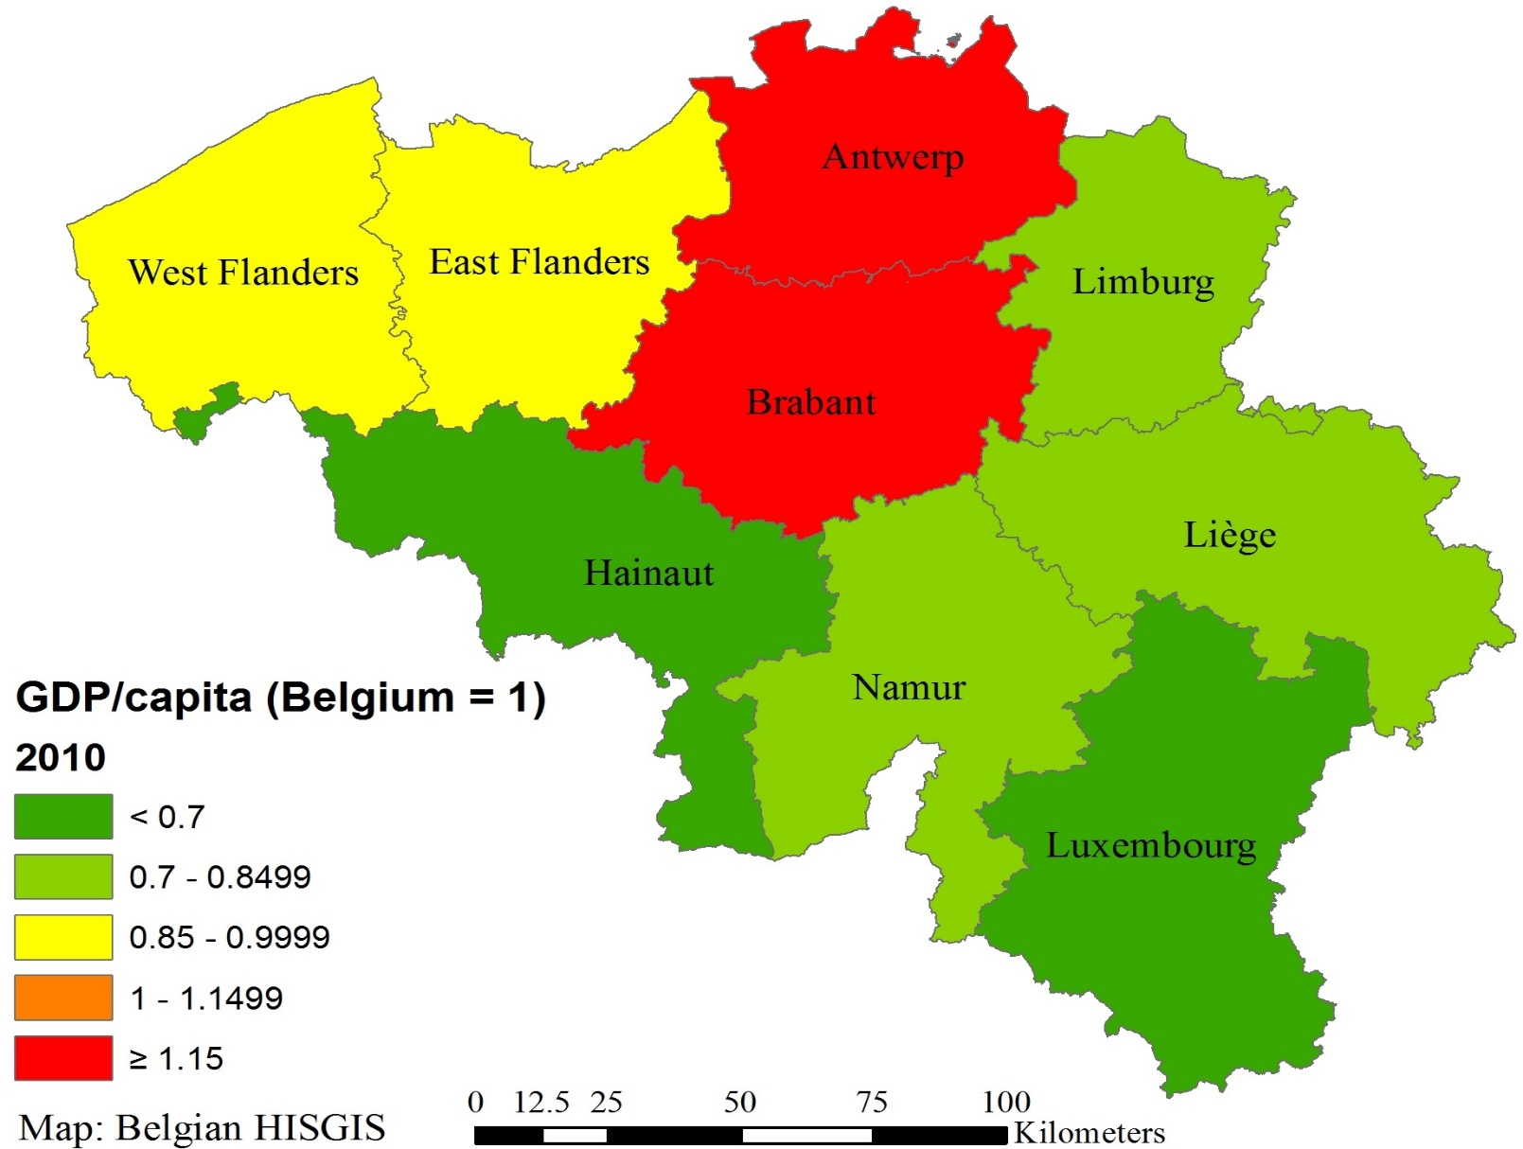
Map 3: Relative regional GDP per capita in 2010 (current prices, Belgium = 1)

Slide 21
Speculations about future developments
Antwerp and Brabant still belong to the richest areas of the EU, but their recent growth performance is lagging behind.
Why are they – and Flanders in general – losing ground?
Sectors that carried industrial growth, such as metal processing and chemicals, are losing steam.
Car assembly even went into a steep decline.
New industrial sectors, biotechnology, are expanding…
Tertiary sector: Flanders is under specialized in ICT-services, finance & insurance, entertainment & recreation.

Slide 22
Conclusion
Economic success in a certain period is no guarantee for economic success in the future.
The process can lead to dramatic changes in spatial inequality.
Today Flanders suffers from a gradual ageing of its economic structure, not unsimilar to what happened in Hainaut and Liège in the 1950s.

Slide 23
Conclusion
The Flemish government fails to stimulate the structural change that Flanders urgently needs.
Structural shortage of industrial zones.
Congestion problems are getting out of control, but no bold investment programs in infrastructure and public transportation.
Wallonia is in a much better position.
Congestion problems still manageable.
Sufficient space to welcome new industries.

