Slide 1
L’efficacité du soutien public pour la R&D et l’innovation
Michel Dumont (Bureau fédéral du Plan)
Congrès des économistes belges de langue française, ULg, 26 novembre 2015

Slide 2
Outline
RATIONALE FOR PUBLIC SUPPORT
TRENDS IN R&D EXPENDITURES AND PUBLIC SUPPORT
TAX INCENTIVES FOR R&D IN BELGIUM
THE IMPACT OF PUBLIC SUPPORT ON R&D OF PRIVATE COMPANIES
CONCLUSIONS

Slide 3
RATIONALE FOR PUBLIC SUPPORT
Market failures in knowledge creation result in underinvestment in R&D by private firms:
  Spillovers: Private firms cannot fully appropriate all the benefits of own investment (social welfare > private benefits)
  Information asymmetry (capital markets): R&D implies high risk and uncertainty ➔ credit constraints
BUT also possible overinvestment (patent race, rent transfer)
General view that public support is warranted ➔ patents, subsidies and tax benefits

Slide 4
TRENDS IN R&D EXPENDITURES AND PUBLIC SUPPORT

Slide 5
Evolution of Gross Expenditures on R&D as a percentage of GDP (2000-2012)
Source: OECD STI 2013

Slide 6
Direct and indirect support for R&D and BERD (% GDP)
Source: OECD STI 2013

Slide 7
TAX INCENTIVES FOR R&D IN BELGIUM

Slide 8
Partial exemption from advance payment of the withholding tax on the wages of (some) R&D employees:
  R&D personnel in companies that cooperate in research with a university, a higher education institution in the European Economic Area or a scientific institution registered by the Council of Ministers (as of 1 October 2005)
  R&D personnel employed by Young Innovative Companies (YIC) (as of 1 July 2006)
  Researchers with a PhD degree in exact or applied sciences, doctor degree in (veterinary) medicine or a civil engineering degree (as of 1 January 2006)
  Researchers with a master's degree, with the exception of masters in social and human sciences (as of 1 January 2007)

Slide 9
Since tax year 2007, Belgian companies can opt for a tax credit rather than the already existing tax deduction for investment in R&D
Starting in tax year 2008, the federal government grants a deduction, from the taxable basis, of 80% of qualifying gross patent income (e.g. income from licensing to third parties).

Slide 10
Budgetary cost of partial exemption from advance payment of withholding tax (2008-2013)

Slide 11
Budgetary cost of tax credit for R&D investment and tax deduction 80% patent income (2008-2012)

Slide 12
THE IMPACT OF PUBLIC SUPPORT ON R&D OF PRIVATE COMPANIES

Slide 13
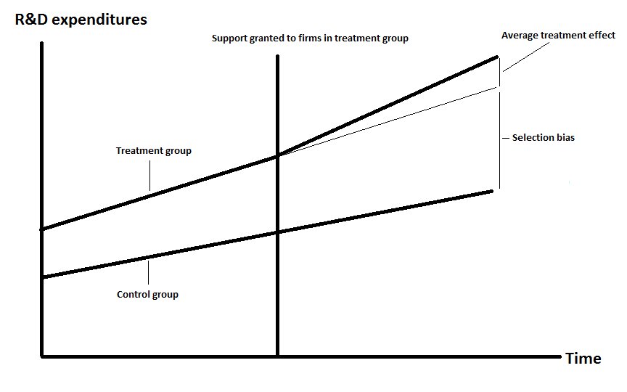
Selection bias vs. treatment effect

Slide 14
Bang for the buck
 | Fixed effects | Selection | Instrumental variables | ECM (long term)
Regional subsidy | 0.59 | 0.45 (without lag R&D) | 3.94 | 0.43
Research cooperation | 2.02-2.28 | - | - | -
Young Innovative Company | - | - | - | -
PhDs and civil engineers | 0.50 -0.60 | - | - | 0.32
Master | 1.37-1.51 | 1.03 (without lag R&D) | 1.94 | 0.74
Tax credit R&D | - | 0.23 (with lag R&D) | - | -
Tax deduction 80% patent income | - | - | - | -

Slide 15
Composition R&D expenditures in Belgium (1993-2011)

Slide 16
CONCLUSIONS

Slide 17
Robust evidence of additionality for regional subsidies and Master, somewhat less for PhDs and Cooperation.
Few indications of impact for YIC and tax credit R&D.
No indications impact tax deduction of patent income.
➔ specific characteristics of support matter

Slide 18
Combination of different schemes reduces additionality (cf. first evaluation).
Indications of non-linear effects of support, generally decrease in additionality for higher rates of support.
Subsidies, YIC scheme and tax deduction 80% patent income appear to shift R&D from D to R.

