Slide 1


The key or the lock? The role of public authorities in the Product-Service System deployment :
case study.

Slide 2
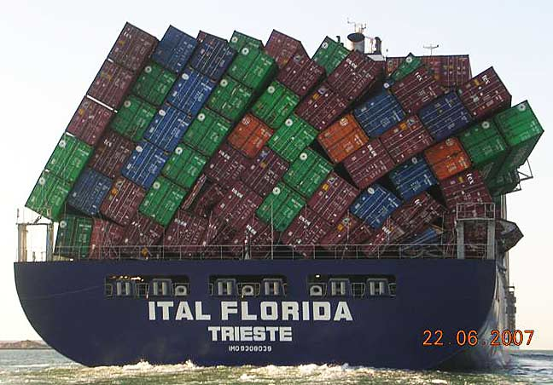


Changes of our production and consumptions patterns
Implies:
Buying the use not the product,
Different types of cooperation between companies,
More complex than simple product sales
→ Volume

Slide 3
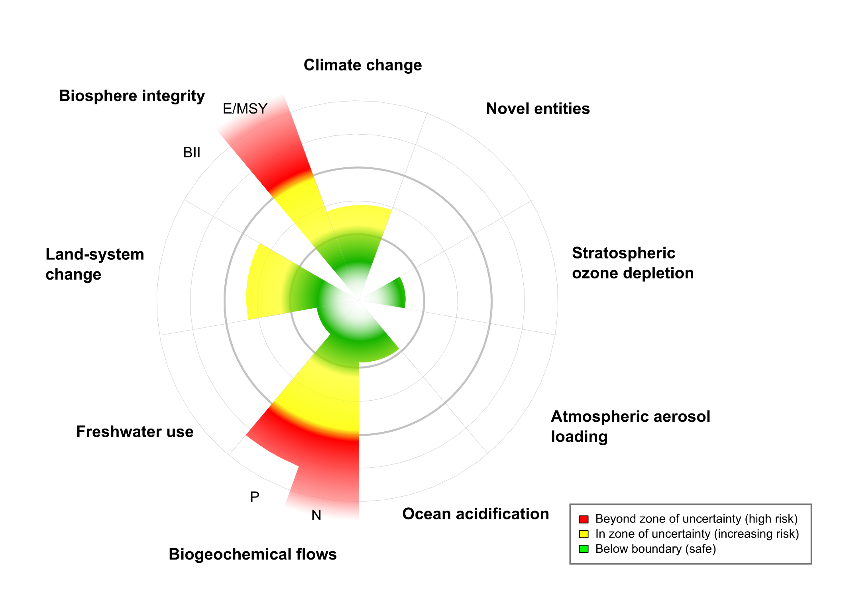
Planetary boundaries
Steffen et al. Science 2015 ; 347 : 1259855

Slide 4



Product-Service System
One of the innovative Business models
Exchange value versus use value
Product
Function
Car
Heating system
Solvent
Mobility
Thermic comfort
Cleaned parts

Slide 5
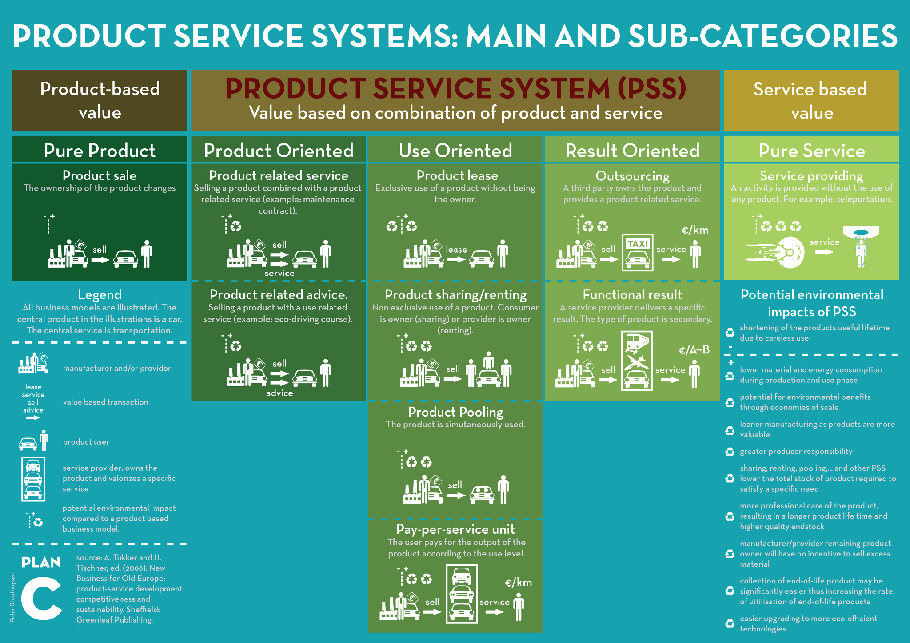
Product-Service System – Typology

Slide 6
Economic and societal advantages
Economic
Societal
Resistance to business cycles
Externalities
Price fluctuation
Margins
Global cost and lifecycle of product
Differentiation and Image
Innovative offer
Semi-industrialisation
Local jobs
One project – multiple impact
…
…
Close relationship with clients
Market penetration
Lack of implementation by SMEs

Slide 7

Case study: Union des Classes Moyennes in Brussels
Eco-conception to Product-Service System
Necessity of
- Economy transition
- Individual + collective support
- Public private co-construction
Support

Slide 8
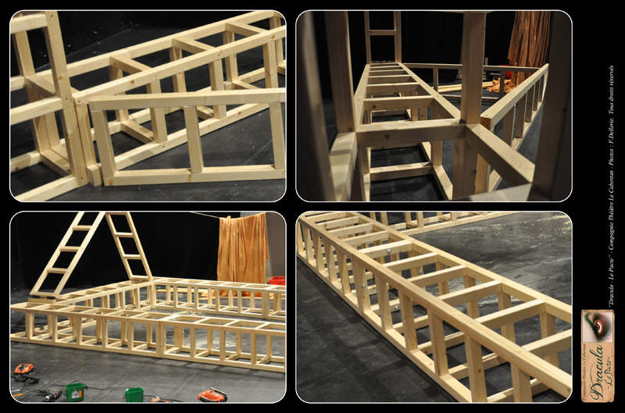
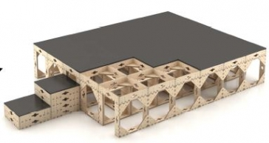
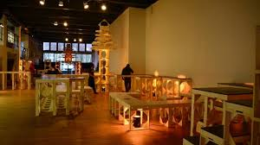
Case study: Union des Classes Moyennes in Brussels
Example

Slide 9


The changing role of public authority
Transition observation
Public procurement stimulation
Consumers and entrepreneur awareness
Finance the (risky) change of business model

Slide 10

Key or lock?
Entrenchment of classical
  economic model
  role of professional organization
          Resistance to change from
              entrepreneurs
              consumers

Slide 11


Conclusion
Changes for all stakeholders in the economic chain: suppliers, customers, consumption patterns, public authorities.
New role for public actors:
Bridging actor

Slide 12
Thank you!
www.acrplus.org
Contact: mc@acrplus.org
Marion Courtois, ACR+

Slide 13
Product-Service System – Typology

