Slide 1
L’ économie circulaire sous l’angle de l’économie environnementale
Johan Eyckmans KU Leuven Faculty Economics and Business campus Brussels Johan.Eyckmans@kuleuven.be http://feb.kuleuven.be/johan.eyckmans

Slide 2
Outline
Introduction
circular economy, resource efficiency, scarcity, recycling
Why should authorities intervene?
Resource scarcity?
Market failures:
Does market mechanism give incentives for transition towards more circular economy?
Which policy instruments to use?
Price based instruments
Extended producer responsibility EPR

Slide 3
Introduction

Slide 4
Linear economy model
= cradle to grave
Raw material producers
Product
market
materials
market
waste
landfill
producers
consumers
incinerate

Slide 5
Circular economy model
= cradle to cradle
Raw material producers
Product
market
materials
market
End-of-life
waste
landfill
producers
consumers
Reuse
Remanufacture
incinerate
Recycle
See: http://www.ellenmacarthurfoundation.org/

Slide 6
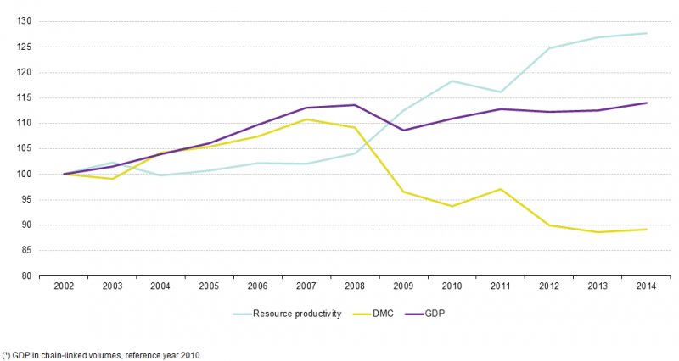
Resource efficiency EU increases?
DMC = Domestic Material Consumption (tons) (domestic extraction + imports – exports)
Resource productivity = GDP/DMC => decoupling?
Source Eurostat

Slide 7
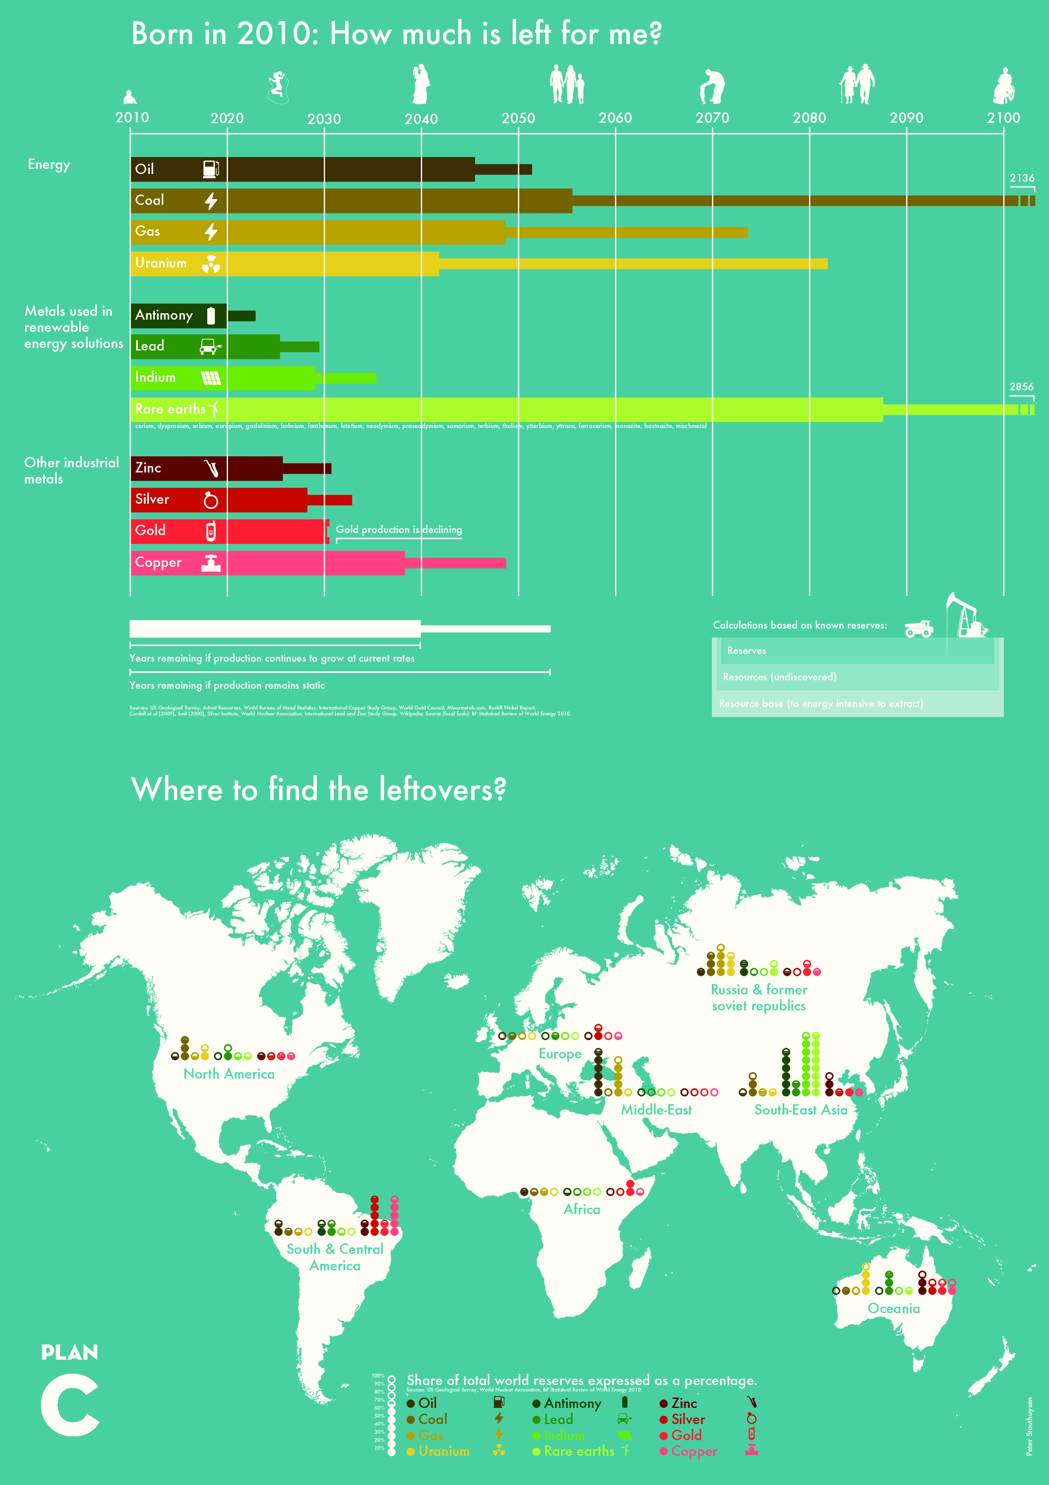
Resource scarcity
Notes:
Source?

Slide 8
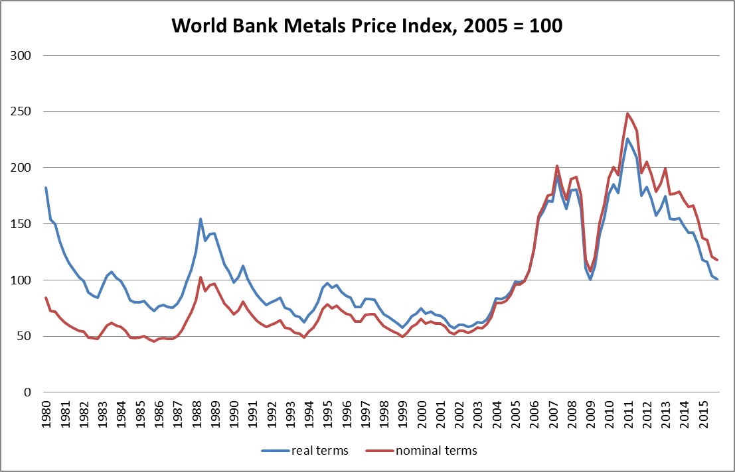
Resource prices go up and down

Slide 9
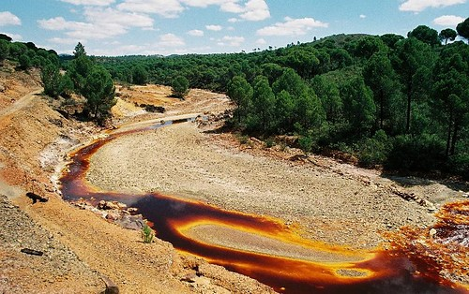
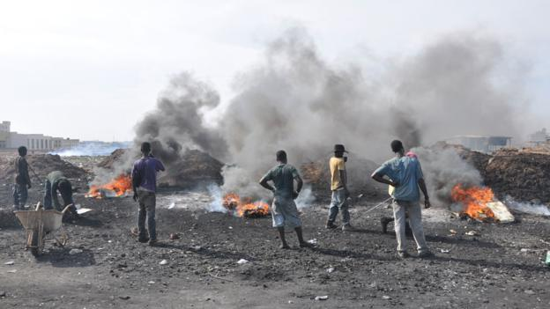
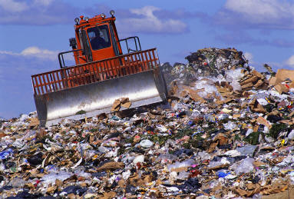
Environmental impacts
During mining and processing of raw materials:
Also during recycling:
And during end-of-life phase

Slide 10
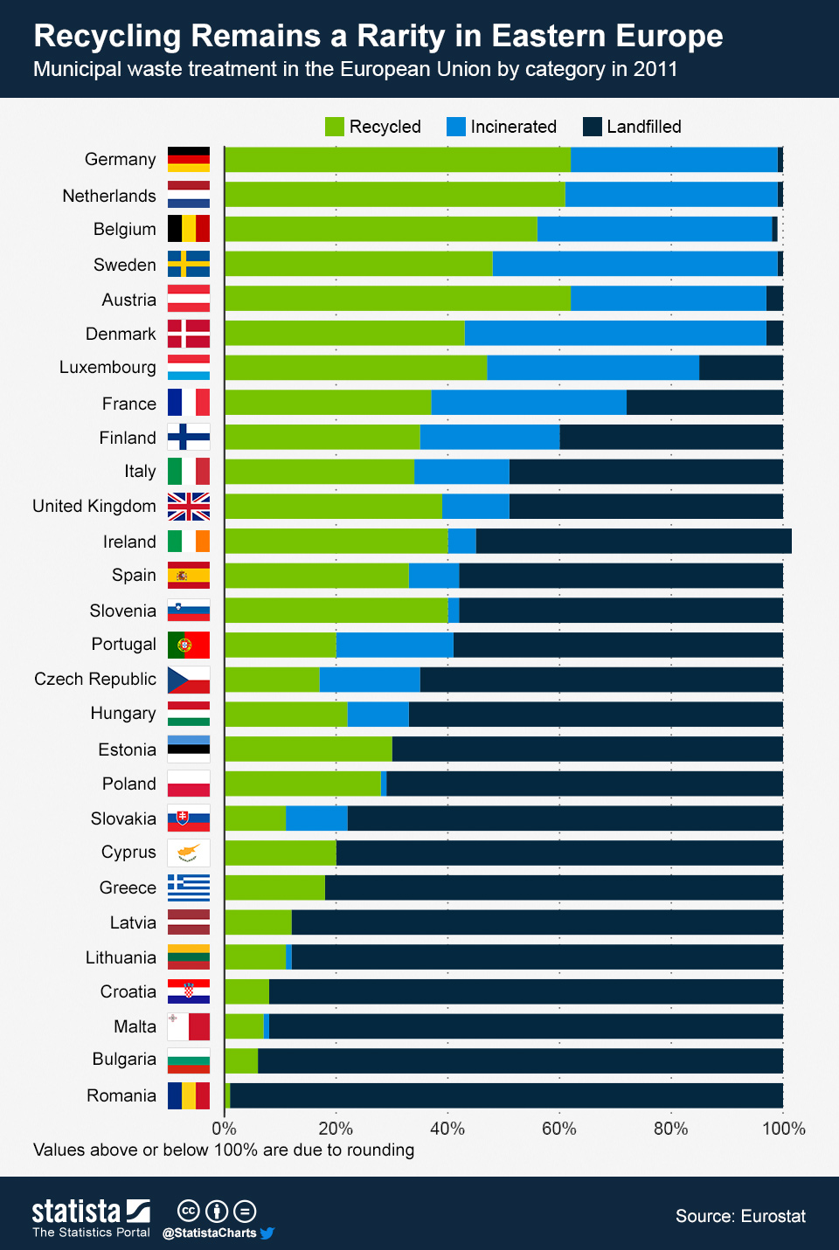
We are recycling champions
Belgium among top recyclers in EU = waste-to-materials WtM
All incineration with energy recovery = waste-to-energy WtE
Almost no land filling anymore

Slide 11
Why should authorities intervene?

Slide 12
What is the ideal situation?
Normative questions:
How fast/slow should non-renewable natural resources be exploited?
How much re-use, recycling, eco-design is optimal from society perspective?
…
Insights from maximizing intertemporal social welfare:
Optimal pace of exploitation depends on rate of time preference
Environmental externalities in entire value chain (production, consumption, end-of-life) should be internalized

Slide 13
Does the market deliver that?
Do markets lead to appropriate pace of extraction of non-renewable natural resources? (using Hotelling model):
Depends on discount rate used by owners/producers: if equal to social discount rate, market outcome and social optimum coincide.
Very unlikely, firms are less patient leading to too high extraction rate
But resource rent (prices) tend to rise over time giving powerful incentives
to invest in R&D for substitutes
to re-use and recycle
Looming scarcity not compelling reason to intervene

Slide 14
Main reason to intervene: environmental externalities
Without intervention, market prices do not reflect negative environmental externalities.
Internalizing environmental externalities remains biggest reason to intervene in materials’ markets
Considering all phases of value chain: resource extraction (mining), production, consumption, end-of-life, recycling phases
Using LCA or other tools to map externalities in system
Global instead of national perspective

Slide 15
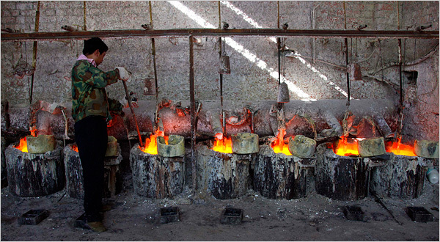
Environmental externalities
Mining and extraction often dirty business
Red mud in bauxite (alumina) production
Rare Earths production China
Mercury and acids in refining / extraction
Market prices do not reflect environmental externalities (market failure)
Free market price < social cost
Also recycling can cause negative environmental impacts

Slide 16
Other reasons to intervene: asymmetric information
Imagine an airplane made of “recycled aluminum”, how would you react?
Difficult to signal equivalent quality of recycled versus virgin material products
Markets collapse (Ackerlof’s market for lemons)
Objective technical standards and labeling can help
Waste of producer A could be resource for producer B
if only B would know of supply and quality of waste
Often non standardized / heterogeneous products
Competitive reasons to hide technical details
Materials’ passport for products?

Slide 17
Other reasons to intervene: technological externalities
Example: insulation producer introduces new high-tech composite insulation material
Strong insulation properties (interesting for consumer)
But difficult to recycle later (multiple materials glued together)
Technological choices of producer making downstream recycling more costly
Design for recycling & eco design incentives in value chain that is not vertically integrated?
Hard for long-lived durable goods
New business models (product service systems, leasing, …)

Slide 18
Other reasons to intervene: strategic behaviour in materials’ markets
Example: Rare Earths used in magnets for wind turbines or LED lights
China controls >90% of market supply
Neodymium: p₂₀₀₉=20$/ton → p₂₀₁₁=350$/ton (and back down to 50$/ton)
Monopolist exploits resources at slower pace than in a competitive market setting
Relaxes resource scarcity problem?
But has a welfare cost (deadweight loss)
And possibly environmental cost:
Slower penetration of LEDs and efficient wind turbines

Slide 19
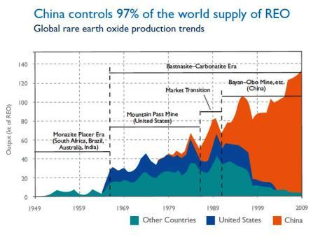
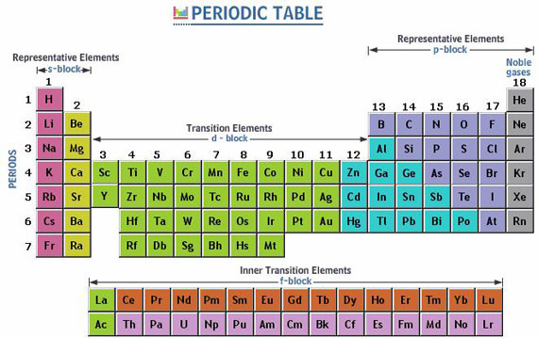
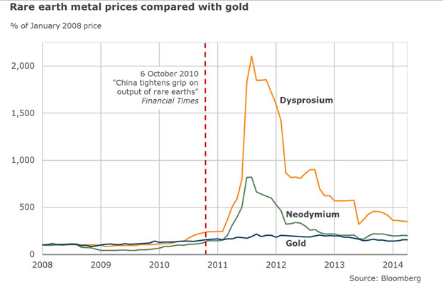
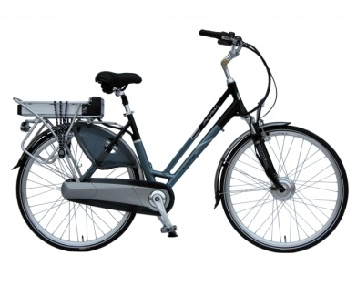
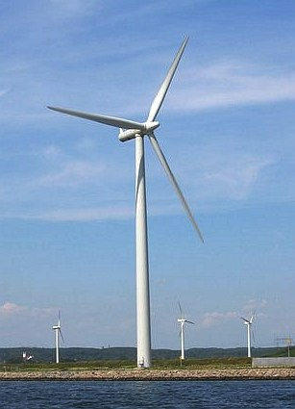
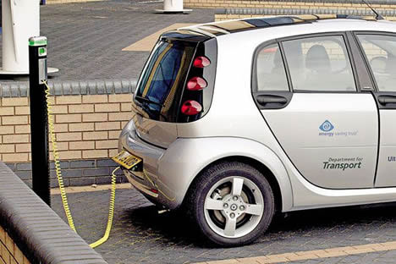
Rare earth metals

Slide 20
Conclusion: need for public intervention?
Because of environmental externalities in production / extraction virgin resources? YES!
Because of information asymmetries? YES!
Because of insufficient incentives for green design, recycling etc? YES!
Because of looming exhaustion of finite resource reserves? PERHAPS
Depends on complex interaction of market failures, technological progress, …

Slide 21
Policy interventions

Slide 22
What policy instruments to be used?
Product ban
Technical standards
Recycling / recycled content targets
Communication & information campaigns
Voluntary cooperation agreement (“convenant”)
Green public procurement
Eco taxes
Tradable recycling certificates
Extended Producer Responsibility EPR
Alternative business models

Slide 23
ECO TAXES

Slide 24
Idea behind eco taxes
Levy tax on remaining emissions of pollutant
Confront producer/consumer with social cost of product “internalize environmental externalities”
Cost efficient
Allocation of emission reduction efforts over polluters with different costs of abatement
Cheap reduction cost polluters should do more effort than expensive ones
Dynamically efficient
Continuous incentive to reduce emissions further because remaining emissions are taxed

Slide 25
Eco taxes internalizing externalities
MC_{S} = MC_{P} + MC_{E}
Too much of the negative externality results in an unregulated market.
Example:
Air pollution caused by burning coal in power station.
p
MC_{S}
E*
MC_{E}
p*
p₀
MC_{P}
MB (=demand)

Slide 26
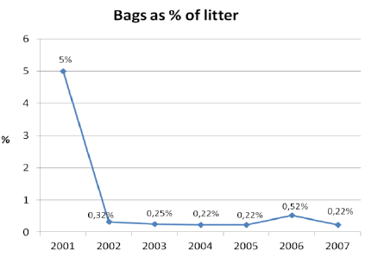
Irish levy on plastic bags (2002)
Idem revenues of Belgian eco tax
(Reference: ACR+, 2013)

Slide 27
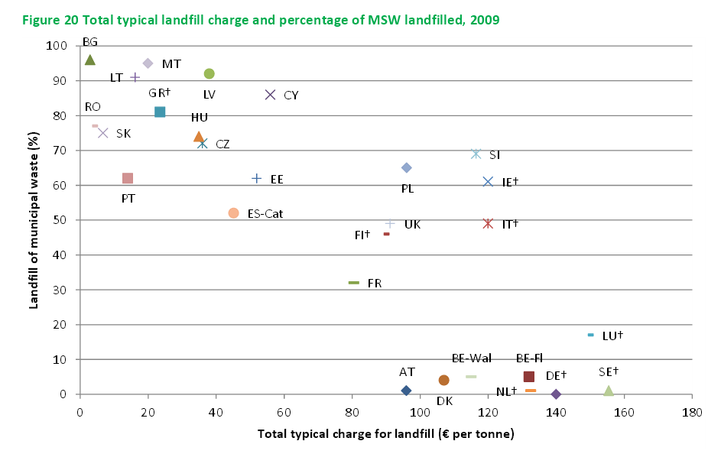
Landfill taxes in Europe
Bron: Bio Intelligence, 2012, Use of economic instruments and waste management performance

Slide 28
Evolving EU waste taxation policies
Past:
Member states should be self-sufficient in waste processing (landfilling, incineration)
Current:
Europe is evolving to a unified market
Intra EU Trade in waste / secondary materials
Competition between Netherlands and Germany for Italian and English waste (MSW)
Importance European policy coherence!
Harmonized use of policy instruments
Avoid environmental tax/standard competition

Slide 29
Extended producer responsibility

Slide 30
Extended Producer Responsibility
Producers have little incentive to limit waste or promote recycling of end-of-life products now.
Link with product vanishes after selling it
EPR: incentivize producers for end-of-life phase
Usual set up:
Regulator sets a recycling target
Industry sets up a recycling organization. Examples: Bebat, Fostplus, Val-I-Pac, …
Members pay recycling organization a rato of volume/weight of products they put into the market
Partial cost recovery selling sorted / recycled materials

Slide 31
EPR schematically
Production phase
Use phase
end-of-life
Virgin resources
Producer
Consumer
Disposal (landfill, …)

Slide 32
EPR schematically
Production phase
Use phase
end-of-life
Virgin resources
Producer
Consumer
Disposal (landfill, …)
Producer Responsibility
Organization PRO
Recycler

Slide 33
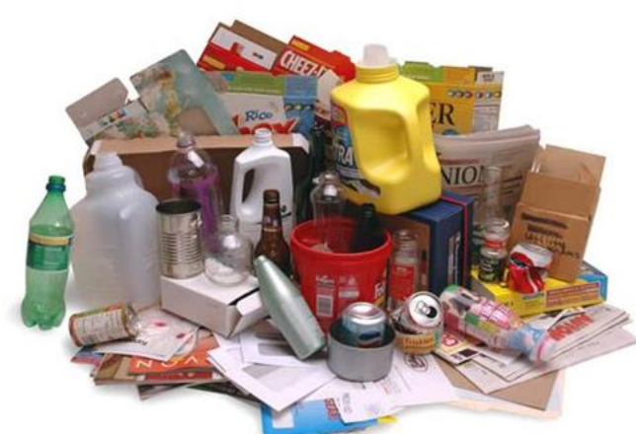
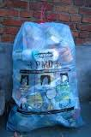
Example: packaging waste
Bottles, cans, …
European legislation: 2004/12/EC
Overall recycling target: 55 %
Glass + paper & cardboard: 60 %
Metals: 50 %
Plastics: 22.5 %
Wood: 15 %
Belgium (3 regions) is more ambitious:
Overall recycling target: 80 %
Plastics: 30 %
Fostplus

Slide 34
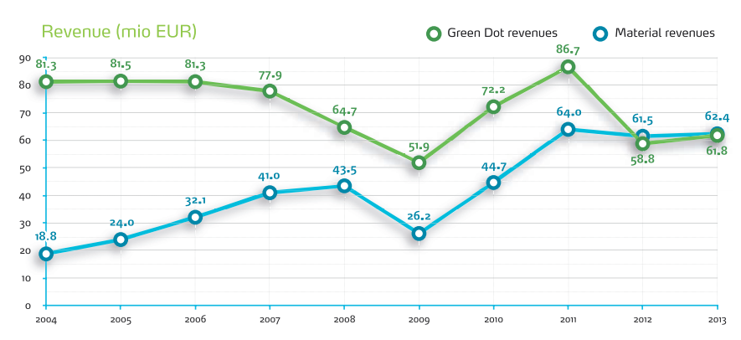
EPR: FostPlus
“Fost Plus is a private organization which promotes, coordinates, and finances the selective collection, sorting, and recycling of household packaging waste in Belgium.”
www.fostplus.be
Costs are covered by membership contributions (50%) and revenues from recycled materials (50%)
low oil price = cheap virgin plastic = low revenues
Fost Plus, 2013, Jaarverslag

Slide 35
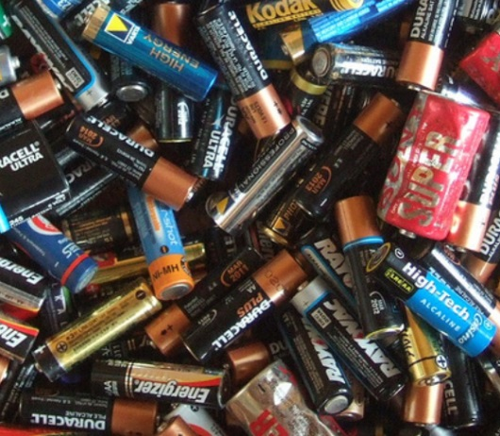
Spent batteries
Batteries
Precious metals
Heavy metals are potentially dangerous for environment in case of inadequate waste treatment
European legislation: 2006/66/EG
Collection target: 45 % by 2016
More stringent targets for specific batteries
lead-acid and nickel-cadmium
Belgium is more ambitious
targets for 2016 apply already now
Industry finances BEBAT

Slide 36
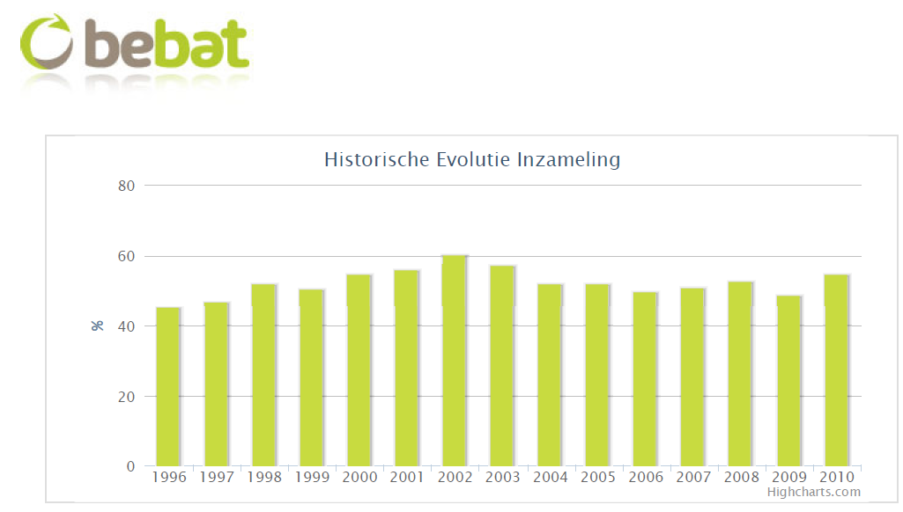
EPR: bebat
Bebat recycles about 55% of all new batteries brought to market in Belgium
But 25% are kept at home and are not returned
and 18% of small batteries ends up in waste bin
Recycling rate remains constant over time

Slide 37
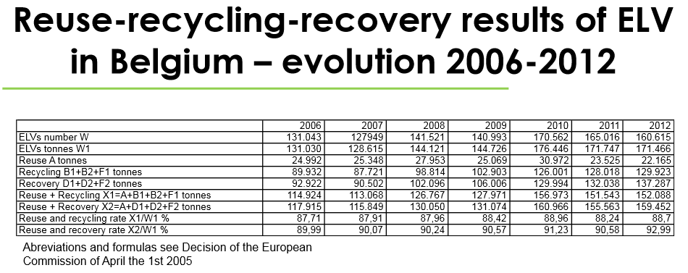
EPR: cars

Slide 38
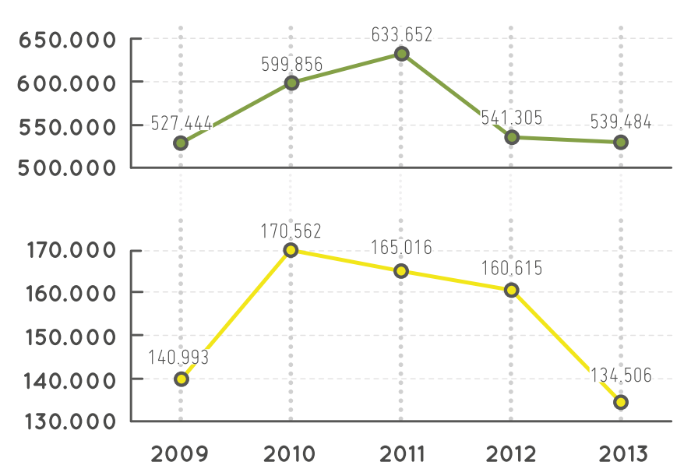
EPR: cars
High recycling percentage(93%) but a lot of our used cars are exported to Africa as second hand cars…
new car inscriptions
old cars processed

Slide 39
EPR as policy instrument
Is EPR a good instrument?
YES: efficient and effective
But room for improvement
Fixed take-back targets are problematic
International coordination?
Combine with tax on non-recycled part?
Some products not covered by EPR yet (durable goods)

Slide 40
Conclusion
Large variety of policy instruments available
Lack of coordination at national level:
Counteracting instruments
And international level:
Race to top & bottom
Evolution towards:
Price based instruments
Eco taxes, tradable permits, …
Extended Producer Responsibility EPR schemes

Slide 41
References
Conrad, J.M. (2010), Resource Economics (Cambridge University Press, Cambridge UK)
Dubois, M., Eyckmans, J. (forthcoming). Efficient waste policies and strategic behavior with open borders. Environmental and Resource Economics
Dubois, M. and Eyckmans, J. (2014), Economic Instruments, in: Reuter, M. and Worrell, E. (eds), The Handbook of Recycling (Elsevier, Amsterdam & New York), Chapter 35, 511–519.
Dubois, M. (2013). Towards a coherent European approach for taxation of combustible waste. Waste Management 33 (8), 1776-1783,
Dubois, M., (2012). Extended producer responsibility for consumer waste: the gap between economic theory and implementation. Waste Management and Research 30, 36-42.
Fullerton, D., Kinnaman, T.C. (1995). Garbage, recycling and illicit burning or dumping. Journal of Environmental Economics and Management 29, 78-91.
Söderholm, P., Tilton, J.E. (2012). Material efﬁciency: an economic perspective. Resources, Conservation and Recycling 61, 75-82.
Tietenberg, T., Lewis, L. (2014). Environmental Economics and Policy, 10th edition. (Pearson Addison-Wesley, Boston).

Slide 42
Thank you
Contact: Johan.Eyckmans@kuleuven.be http://feb.kuleuven.be/johan.eyckmans

